Slide 1
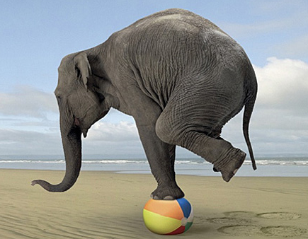
Finding Feedback Balance
CRLA Topic (Level II): Tutoring in Specific Skills or Subjects
By: Kassie Lamoreaux, MTESOL
Academic Skills Center Coordinator

Slide 2
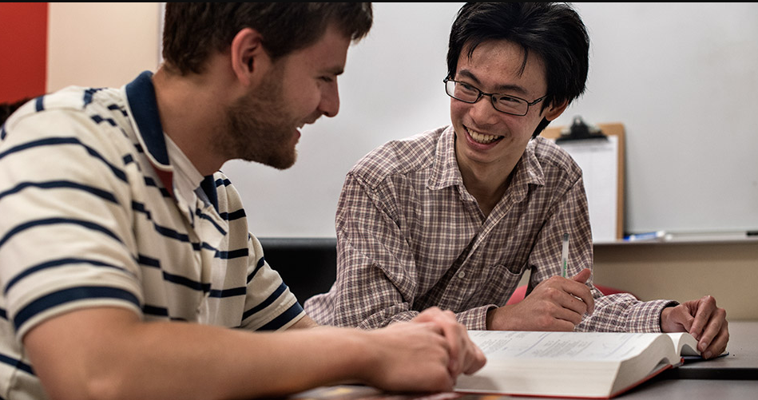
PRACTICE PARAGRAPH
What issues do you see in this writing?
What suggestions for improvement do you have for this paragraph?

Slide 3
PRACTICE PARAGRAPH
Assignment Prompt:
In class, we watched a short film. From your notes, answer these questions: (Do NOT summarize the film)
Why do you think the documentary was so controversial?
What do you think was the most effective part or aspect of the film. Why?
What was this film’s overall message?
Write 1-2 pages, formatted in MLA. Due 11/3/17 at midnight.

Slide 4
Questions to Consider
What is the assignment?
How long is it supposed to be?
When is it due?
Are they answering the question? Or are they off topic?
Do they need to add or cut ideas?
What can I scaffold for them?
I wrote a blog about this once. You can find it at esldrummer.weebly.com

Slide 5
How do you feel when a student says…
“I just want help with grammar.”
“Can you just ‘check’ it?”
“I just want you to read it and/or fix it.”
“Can you tell me if it’s alright?”

Slide 6
We’re not a laundromat…
We do help with grammar,
though… right?

Slide 7
How do we find that balance?
Teach the writing process
Tell them the secret to grading writing
Read the assignment instructions with them.

Slide 8
How do we find that balance?
PRACTICE ESSAY

Slide 9
Works Cited
Bell, Diana Calhoun and Sara Redington Elledge. “Dominance and Peer Tutoring Sessions with English Language Learners.” TLAR, vol. 13, no. 1, 2008, pp. 17-29.
Lamoreaux, Kassie. “The First 4 Questions for Online Tutoring.” esldrummer.weebly.com, 9 August 2016, http://esldrummer.weebly.com/i-heart-esl/the-first-4- questions-for-online-tutoring
Raymond, Laurel and Zarah Quinn. “What a Writer Watns: Assessing Fulfillment of Student Goals in Writing Center Tutoring Sessions.” The Writing Center Journal, vol. 32, no. 1, 2012, pp. 64-76.

Slide 10
Thank you!
Any questions?
kassie.lamoreaux@mesacc.edu

